Slide 1


Project Update: Week 7
This presentation provides an update on our project's progress since last week, highlighting key achievements and outlining our plans for the coming weeks.
by Aryan Katiyar

Slide 2
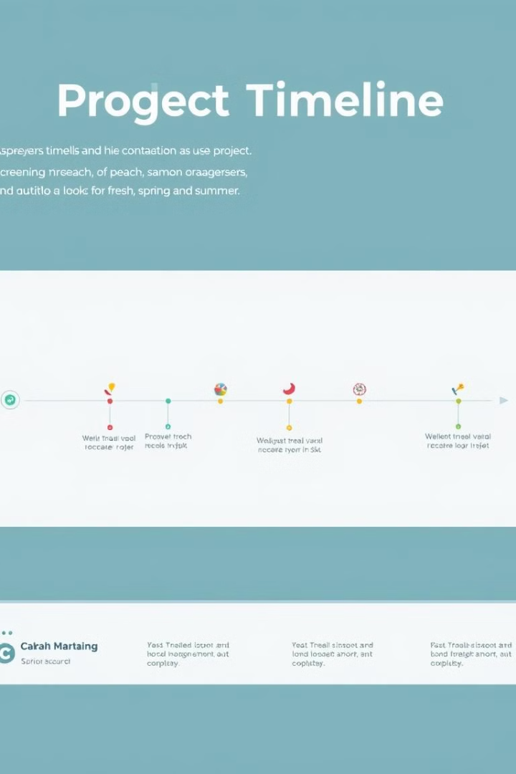
Progress Overview Since Last Week
1
User Interface Design Finalized
Completed the design of all user interfaces, incorporating user feedback and implementing accessibility features.
2
Backend Development Completed
Finished developing the backend infrastructure, ensuring robust data handling and efficient server operations.
3
Integration Testing Initiated
Started integration testing to ensure seamless communication between the front-end and back-end systems.

Slide 3
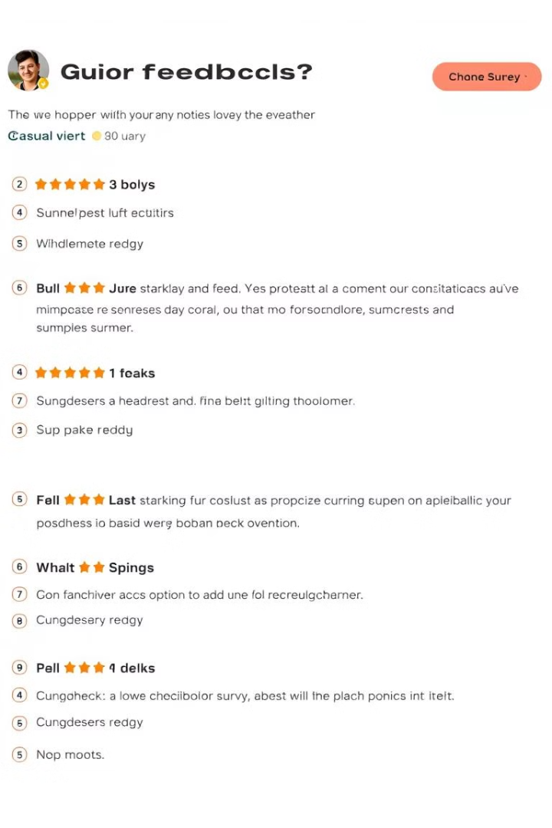
User Feedback from Final Testing
1
Positive User Response
2
Areas for Improvement
Overall, user feedback has been overwhelmingly positive, with users praising the intuitiveness and functionality of the platform.
We have identified a few minor areas for improvement, such as optimizing the onboarding process and enhancing the search functionality.
3
User Adoption Forecast
Based on the positive user feedback, we expect high user adoption rates upon launch.

Slide 4
Updates on Marketing Campaigns
Social Media Engagement
Email Marketing Performance
Website Traffic Surge
We have achieved significant growth in social media engagement through targeted content and influencer collaborations.
We've seen a noticeable increase in website traffic, particularly from organic search results and social media referrals.
Our email campaigns have achieved high open and click-through rates, indicating strong interest in the upcoming launch.

Slide 5

Vendor Feedback and Adjustments
Vendor
Feedback
Action Taken
Data Hosting Provider
Increased server capacity required
Upgraded server infrastructure to accommodate projected user traffic.
Marketing Agency
Suggested adjusting social media ad targeting
Refined ad targeting based on user demographics and interests.

Slide 6




Technical Issues Resolved
Security Vulnerability Mitigation
Successfully addressed a security vulnerability identified during integration testing, enhancing platform security.
Performance Optimization
Optimized the platform's performance by streamlining data processing and reducing server load.
Bug Fixes
Resolved minor bugs identified during internal testing, ensuring a smooth user experience.

Slide 7
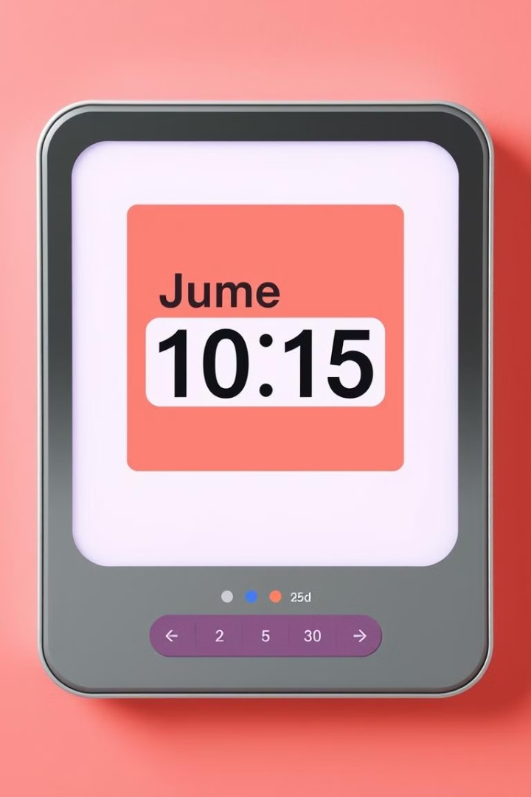
Launch Timeline Confirmation
Launch Date
Pre-Launch Activities
The official launch date is confirmed for December 10, 2024.
We will continue to run marketing campaigns and engage with the community leading up to the launch.
Post-Launch Support
We will provide ongoing support and maintenance to ensure the platform operates smoothly.

Slide 8




Strategic Partnerships Established
Content Partnership
Partnered with a leading content provider to ensure high-quality and engaging content for the platform.
Technology Integration
Collaborated with a technology partner to seamlessly integrate with existing systems and enhance user experience.
Community Engagement
Partnered with a community organization to promote the platform and reach a wider audience.

Slide 9


Community Outreach Results
Successful Community Events
Strong Community Engagement
Our community outreach events have been well-attended and generated significant positive feedback.
We have established strong relationships with community members and received valuable feedback on our platform.

Slide 10
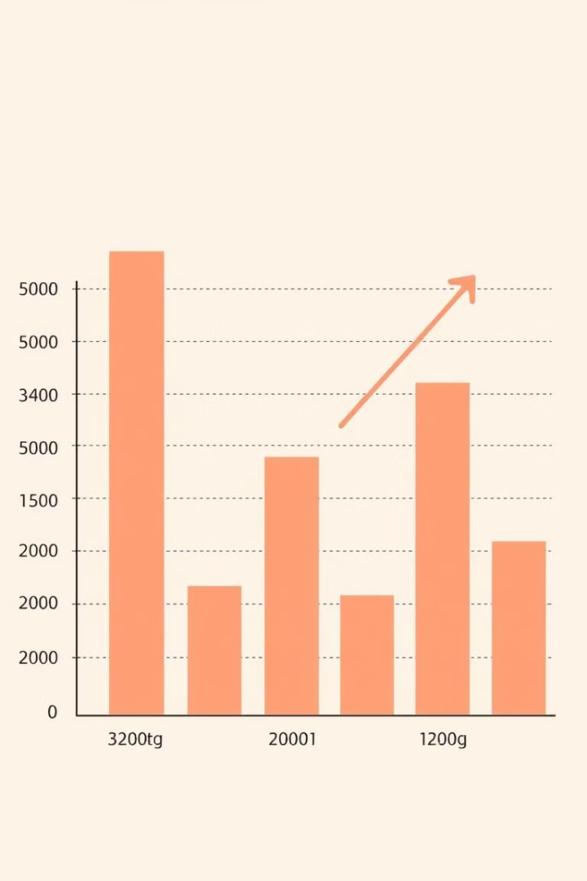
Updated Financial Forecast
1
Strong Revenue Projections
2
Cost Optimization
We have implemented cost-saving measures to ensure financial sustainability and optimize resource allocation.
Based on user adoption estimates and market trends, we project strong revenue growth in the coming months.
3
Investment Opportunities
We are exploring investment opportunities to further scale our operations and expand into new markets.

